Slide 1

- Telerik - Automated Testing Software
Nhóm 1

Slide 2

Contents
What’s automated - 01 Testing software?
03 - Telerik’s Testing Types?
Why’s Telerik? - 02
04 - Demo

Slide 3

GROUP MEMBERS:
Huỳnh Thế Hiển
Cao Quỳnh Trang
thehienvnag@gmail.com
trangcaoquynh1207@gmail.com
Đồng Hữu Long
Đỗ Đức Nam
thaiduc@gmail.com
namdoduc.hcm@gmail.com
Hứa Nhật Quang
Ngô Vũ Khả Minh
quanghnse140846@fpt.edu.vn
anhkhaLover@gmail.com

Slide 4

What is automated
Testing software?

Slide 5
Testing is a must to meet with development cycles of Agile/CD/CI.
Along with the need of quick delivery, the better improvement, the higher capabilities of the product.
=> Testing is putting a strain on Tester.

Slide 6
However, most of the automated testing approaches aren’t much supported to QA Testers without much coding experience.
=> Automated Testing software appeared as a savior.

Slide 7







Slide 8
02. Why’s Telerik?

Slide 9


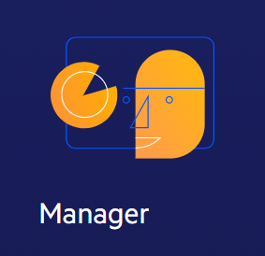
- Telerik Enable Automated Testing for Everyone, with or Without Code

Slide 10
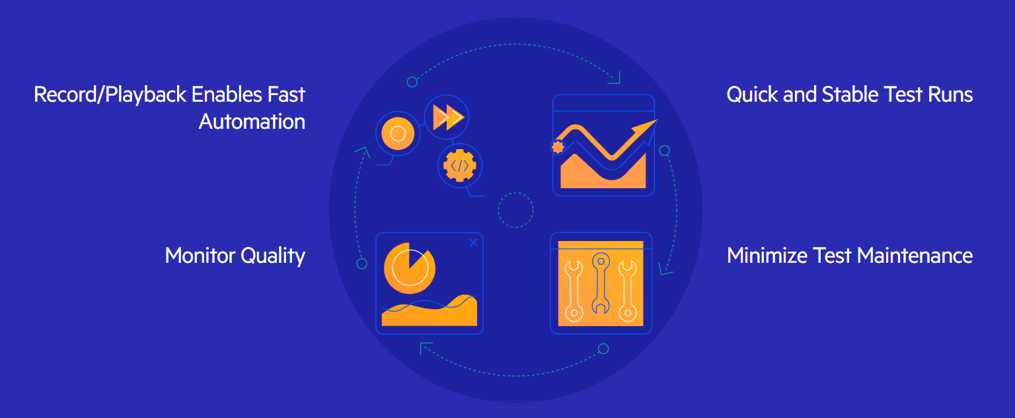
Element detection makes tests more stable and reliable.
Test maintenance is minimized.

Slide 11
03. Telerik Testing Types?

Slide 12
Functional Testing
Create, run and maintain automated functional tests for Web and WPF applications
Intuitive Recorder with cross-browser support
Data-driven testing
Intelligent hybrid element detection
Executive Dashboard – web results and reports
Integrated Scheduling and concurrent runs on multiple remote machines
CI/CD Integration

Slide 13
API Testing
Verify the integrity and reliability of your APIs or enhance your web functional testing with API calls.
Codelessly test RESTful Services
Fiddler integration
Flexible verifications
Use API calls in web functional tests

Slide 14
Load Testing
Get a better understanding of how your website might perform if simultaneously visited by a large number of users.
Convert existing web functional tests to load tests
Detailed server performance and stability reports
Use suggested dynamic targets or create custom

Slide 15
04. Demo

Slide 16

REFERENCES
Automated Testing That Just Works. - Link

Slide 17

THANK YOU FOR YOUR ATTENTION!

